Slide 1
Chapter 14 Normalization

Slide 2
Content
Informal guidelines for relational schemas
Functional dependencies
BCNF
2NF and 3NF
Normal forms based on Primary keys

Slide 3
Informal Design Guideline for Relation Schemas
We will discuss four informal guidelines that may be used as measures to determine the quality of relation schema design:
Making sure that the semantics of the attributes is clear in the schema
Reducing the redundant information in tuples
Reducing the NULL values in tuples
Disallowing the possibility of generating spurious tuples

Slide 4
Informal Design Guideline for Relation Schemas
Imparting Clear Semantics to Attributes in Relations
semantics of a relation:
refers to its meaning resulting from the interpretation of attribute values in a tuple.
i.e., what a relation exactly means and stands for

Slide 5
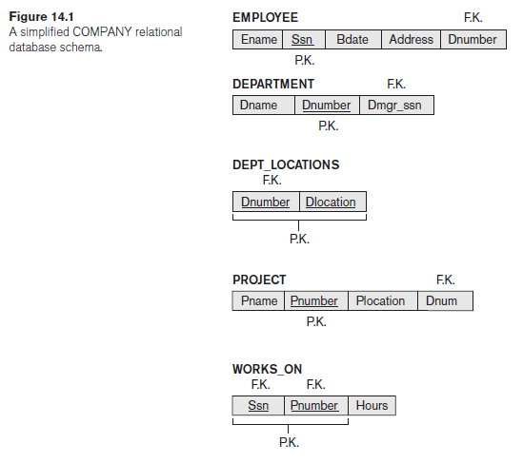
Informal Design Guideline for Relation Schemas
Imparting Clear Semantics to Attributes in Relations
The meaning of the EMPLOYEE relation schema is simple:
Each tuple represents an employee, with values for:
the employee’s name (Ename),
Social Security number (Ssn),
birth date (Bdate),
address (Address),
number of the department that the employee works for (Dnumber).
Dnumber attribute: A FK that represents a relationship between EMPLOYEE and DEPARTMENT.
The semantics of the DEPARTMENT and PROJECT schemas are also straightforward:
Each DEPARTMENT tuple represents a department entity,
Each PROJECT tuple represents a project entity.
The attribute Dmgr_ssn of DEPARTMENT relates a department to the employee who is its manager,
whereas Dnum of PROJECT relates a project to its controlling department; both are foreign key attributes.

Slide 6
Informal Design Guideline for Relation Schemas
Imparting Clear Semantics to Attributes in Relations
Each tuple in DEPT_LOCATIONS gives
a department number (Dnumber)
and one of the locations of the department (Dlocation).
Each tuple in WORKS_ON gives
an employee Social Security number (Ssn),
the project number of one of the projects that the employee works on (Pnumber),
and the number of hours per week that the employee works on that project (Hours).

Slide 7
Informal Design Guideline for Relation Schemas
Imparting Clear Semantics to Attributes in Relations
Guideline 1.
Design a relation schema so that it is easy to explain its meaning.
Do not combine attributes from multiple entity types and relationship types into a single relation.
If a relation schema corresponds to one entity type or one relationship type, it is straightforward to explain its meaning.
Otherwise, if the relation corresponds to a mixture of multiple entities and relationships, semantic ambiguities will result, and the relation cannot be easily explained.

Slide 8
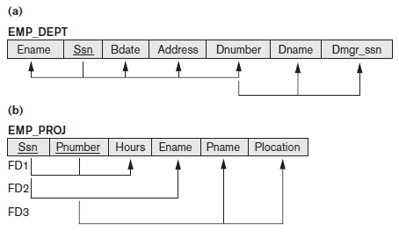
Informal Design Guideline for Relation Schemas
Imparting Clear Semantics to Attributes in Relations
Guideline 1.
Examples of Violating Guideline 1
The relation schemas in Figures (a) and (b) also have clear semantics.
A tuple in the EMP_DEPT relation schema in Figure (a) represents a single employee but includes, along with the Dnumber (the identifier for the department he/she works for), additional information—namely, the name (Dname) of the department for which the employee works and the Social Security number (Dmgr_ssn) of the department manager.

Slide 9
Informal Design Guideline for Relation Schemas
Imparting Clear Semantics to Attributes in Relations
Guideline 1.
Examples of Violating Guideline 1
For the EMP_PROJ relation in Figure 14.3(b), each tuple relates an employee to a project but also includes the employee name (Ename), project name (Pname), and project location (Plocation).
Although there is nothing wrong logically with these two relations, they violate Guideline 1 by mixing attributes from distinct real-world entities:
EMP_DEPT mixes attributes of employees and departments, and EMP_PROJ mixes attributes of employees and projects and the WORKS_ON relationship.

Slide 10
Informal Design Guideline for Relation Schemas
Redundant Information in Tuples and Update Anomalies
One goal of schema design is to minimize the storage space used by the base relations.
For example,
compare the space used by the two base relations EMPLOYEE and DEPARTMENT with that for an EMP_DEPT base relation, (which is the result of applying the NATURAL JOIN operation to EMPLOYEE and DEPARTMENT).
In EMP_DEPT, the attribute values pertaining to a particular department (Dnumber, Dname, Dmgr_ssn) are repeated for every employee who works for that department.

Slide 11
Informal Design Guideline for Relation Schemas
Redundant Information in Tuples and Update Anomalies
In contrast, each department’s information appears only once in the DEPARTMENT relation.
Only the department number (Dnumber) is repeated in the EMPLOYEE relation for each employee who works in that department as a foreign key.
Similar comments apply to the EMP_PROJ relation (see Figure 14.4), which augments the WORKS_ON relation with additional attributes from EMPLOYEE and PROJECT.

Slide 12
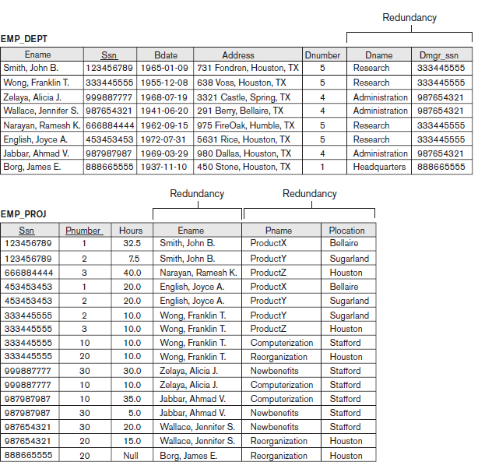
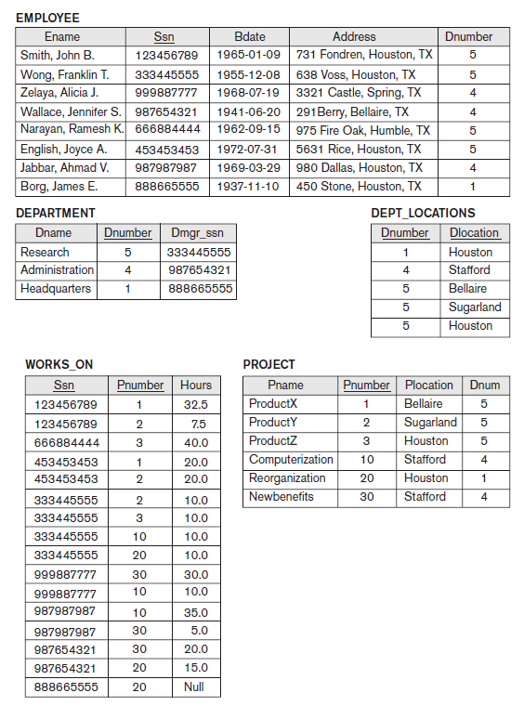
Informal Design Guideline for Relation Schemas

Slide 13
Informal Design Guideline for Relation Schemas
Redundant Information in Tuples and Update Anomalies
Storing natural joins of base relations leads to an additional problem referred to as update anomalies.
These can be classified into:
insertion anomalies,
deletion anomalies,
modification anomalies.
Insertion Anomalies. Insertion anomalies can be differentiated into two types, illustrated by the following examples based on the EMP_DEPT relation.

Slide 14
Informal Design Guideline for Relation Schemas
Redundant Information in Tuples and Update Anomalies
Insertion Anomalies
To insert a new employee tuple into EMP_DEPT, we must include either the attribute values for the department that the employee works for, or NULLs (if the employee does not work for a department as yet).
For example, to insert a new tuple for an employee who works in department number 5, we must enter all the attribute values of department 5 correctly so that they are consistent with the corresponding values for department 5 in other tuples in EMP_DEPT.
In Figure 2, we do not have to worry about this consistency problem because we enter only the department number in the employee tuple; all other attribute values of department 5 are recorded only once in the database, as a single tuple in the DEPARTMENT relation.

Slide 15
Informal Design Guideline for Relation Schemas
Redundant Information in Tuples and Update Anomalies
It is difficult to insert a new department that has no employees as yet in the EMP_DEPT relation.
The only way to do this is to place NULL values in the attributes for employee.
This violates the entity integrity for EMP_DEPT because its primary key SSN cannot be null.
This problem does not occur in the design of Figure 14.2 because a department is entered in the DEPARTMENT relation whether any employees work for it or not, and whenever an employee is assigned to that department, a corresponding tuple is inserted in EMPLOYEE.

Slide 16
Informal Design Guideline for Relation Schemas
Redundant Information in Tuples and Update Anomalies
Deletion Anomalies.
If we delete from EMP_DEPT,
and that employee is the last employee working in a particular department,
then the information related to that department will be lost as well.
This problem does not occur in the 14.2 designed database because DEPARTMENT tuples are stored separately.

Slide 17
Informal Design Guideline for Relation Schemas
Redundant Information in Tuples and Update Anomalies
Modification Anomalies.
In EMP_DEPT, if we change the value of one of the attributes of a particular department
—say, the manager of department 5
—we must update the tuples of all employees who work in that department;
otherwise, the database will become inconsistent.

Slide 18
Informal Design Guideline for Relation Schemas
Redundant Information in Tuples and Update Anomalies
Guideline 2.
Design the base relation schemas so that no insertion, deletion, or modification anomalies are present in the relations.
These guidelines may sometimes have to be violated in order to improve the performance of certain queries.
For example,
If EMP_DEPT is stored as a materialized view in addition to the base relations of EMPLOYEE and DEPARTMENT, the anomalies in EMP_DEPT must be noted and accounted for
for example, by using triggers or stored procedures that would make automatic updates.
This way, whenever the base relation is updated, we do not end up with inconsistencies.

Slide 19
Informal Design Guideline for Relation Schemas
NULL Values in Tuples
Problem 1:
If most of the attributes do not apply to all tuples in the relation, then we have many NULLs in the tuples.
This can waste space at the storage level.
Problem 2:
What to do with NULLs when aggregate operations such as COUNT or SUM are applied.
Problem 3:
SELECT and JOIN operations involve comparisons; with NULL the results may become unpredictable.

Slide 20
Informal Design Guideline for Relation Schemas
NULL Values in Tuples
Moreover, NULLs can have multiple interpretations, such as the following:
The attribute does not apply to this tuple. For example, Visa_status may not apply to U.S. students.
The attribute value for this tuple is unknown. For example, the Date_of_birth may be unknown for an employee.
The value is known but absent; that is, it has not been recorded yet. For example, the Home_Phone_Number for an employee may exist, but may not be available and recorded yet.

Slide 21
Informal Design Guideline for Relation Schemas
NULL Values in Tuples
Guideline 3.
Avoid placing attributes in a base relation whose values may frequently be NULL.
If NULLs are unavoidable,
apply in exceptional cases only
and do not apply to most tuples in the relation.
For example,
if only 15% of employees have individual offices,
Then there is no need to include an attribute Office_number in the EMPLOYEE relation;
rather, a relation EMP_OFFICES (Essn, Office_number) can be created to include tuples for only the employees with individual offices.

Slide 22
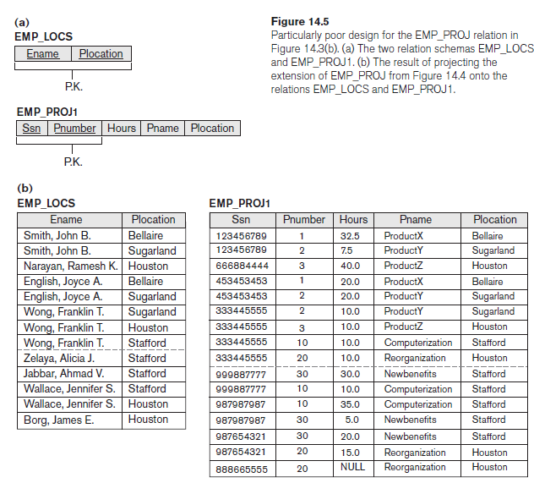
Informal Design Guideline for Relation Schemas
Generation of Spurious Tuples

Slide 23
Informal Design Guideline for Relation Schemas
Generation of Spurious Tuples
Spurious tuples: tuples that actually doesn't exists in a table.
Consider the two relation schemas EMP_LOCS and EMP_PROJ1.
A tuple in EMP_LOCS means that the employee whose name is Ename works on at least one project located at Plocation.
A tuple in EMP_PROJ1 refers to the fact that the employee whose Social Security number is Ssn works the given Hours per week on the project whose name, number, and location are Pname, Pnumber, and Plocation.

Slide 24
Informal Design Guideline for Relation Schemas
Generation of Spurious Tuples
Figure 14.5(b) shows relation states of EMP_LOCS and EMP_PROJ1 corresponding to the EMP_PROJ relation in Figure 14.4.

Slide 25
Informal Design Guideline for Relation Schemas
Generation of Spurious Tuples
Suppose that we used EMP_PROJ1 and EMP_LOCS as the base relations instead of EMP_PROJ.
This produces a particularly bad schema design because we cannot recover the information that was originally in EMP_PROJ from EMP_PROJ1 and EMP_LOCS.
If we attempt a NATURAL JOIN operation on EMP_PROJ1 and EMP_LOCS, the result produces many more tuples than the original set of tuples in EMP_PROJ.

Slide 26
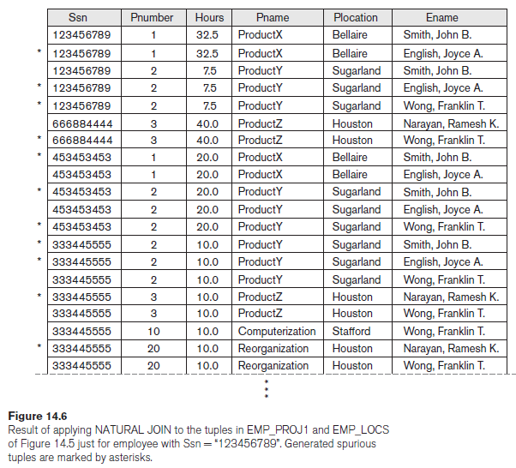
Informal Design Guideline for Relation Schemas
Generation of Spurious Tuples
In Figure 14.6, the result of applying the join to only the tuples for employee with Ssn = “123456789” is shown (to reduce the size of the resulting relation).
Additional tuples that were not in EMP_PROJ are called spurious tuples because they represent spurious information that is not valid.
The spurious tuples are marked by asterisks (*) in Figure 14.6.

Slide 27
Informal Design Guideline for Relation Schemas
Generation of Spurious Tuples
Decomposing EMP_PROJ into EMP_LOCS and EMP_PROJ1 is undesirable because when we JOIN them back using NATURAL JOIN, we do not get the correct original information.
This is because in this case Plocation happens to be the attribute that relates EMP_LOCS and EMP_PROJ1, and Plocation is neither a primary key nor a foreign key in either EMP_LOCS or EMP_PROJ1.
Guideline 4.
Design relation schemas so that they can be joined with equality conditions on attributes that are appropriately related (primary key, foreign key) pairs in a way that guarantees that no spurious tuples are generated.
Join should be done on whole PK projected as FK in another table, not a portion of that.
Avoid relations that contain matching attributes that are not (foreign key, primary key) combinations because joining on such attributes may produce spurious tuples.

Slide 28
Informal Design Guideline for Relation Schemas
Summary and Discussion of Design Guidelines
The problems are:
■ Anomalies that cause redundant work to be done during insertion into and modification of a relation, and that may cause accidental loss of information during a deletion from a relation
■ Waste of storage space due to NULLs and the difficulty of performing selections, aggregation operations, and joins due to NULL values
■ Generation of invalid and spurious data during joins on base relations with matched attributes that may not represent a proper (foreign key, primary key) relationship
Strategy for achieving a good design:
decompose a badly designed relation appropriately to achieve higher normal forms.

Slide 29
Functional Dependencies
Definition of Functional Dependency
A functional dependency is a constraint between two sets of attributes from the database.
EXAMPLE:
Suppose that our relational database schema has n attributes A1, A2,… , An; let us think of the whole database as being described by a single universal relation schema
R = {A1, A2, … , An}.
Definition:
A functional dependency, denoted by X → Y, between two sets of attributes X and Y that are subsets of R specifies a constraint on the possible tuples that can form a relation state r of R.
The constraint is that, for any two tuples t1 and t2 in r that have t1[X] = t2[X], they must also have t1[Y] = t2[Y].

Slide 30
Functional Dependencies
Definition of Functional Dependency
EXAMPLE:
This means that the values of the Y component of a tuple in r depend on, or are determined by, the values of the X component; alternatively, the values of the X component of a tuple uniquely (or functionally) determine the values of the Y component.
We also say that there is a functional dependency from X to Y, or that Y is functionally dependent on X.
The abbreviation for functional dependency is FD or f.d.
The set of attributes X is called the left-hand side of the FD, and Y is called the right-hand side.

Slide 31
Functional Dependencies
Definition of Functional Dependency
Note the following:
If a constraint on R states that there cannot be more than one tuple with a given X-value in any relation instance r(R)—that is, X is a candidate key of R—this implies that X → Y for any subset of attributes Y of R (because the key constraint implies that no two tuples in any legal state r(R) will have the same value of X). If X is a candidate key of R, then X → R.
If X → Y in R, this does not say whether or not Y → X in R.

Slide 32
Functional Dependencies
Definition of Functional Dependency
Consider the relation schema EMP_PROJ in Figure 14.3(b); from the semantics of the attributes and the relation, we know that the following functional dependencies should hold:
a. Ssn → Ename
b. Pnumber → {Pname, Plocation}
c. {Ssn, Pnumber} → Hours
These functional dependencies specify that:
(a) the value of an employee’s Social Security number (Ssn) uniquely determines the employee name (Ename),
(b) the value of a project’s number (Pnumber) uniquely determines the project name (Pname) and location (Plocation),
(c) a combination of Ssn and Pnumber values uniquely determines the number of hours the employee currently works on the project per week (Hours).

Slide 33
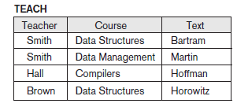
Functional Dependencies
Definition of Functional Dependency
A functional dependency is a property of the relation schema R, not of a particular legal relation state r of R.
For example, Figure 14.7 shows a particular state of the TEACH relation schema.
We may think that Text → Course, we cannot confirm this unless we know that it is true for all possible legal states of TEACH.
For example, because ‘Smith’ teaches both ‘Data Structures’ and ‘Database Systems,’ we can conclude that Teacher does not functionally determine Course.

Slide 34
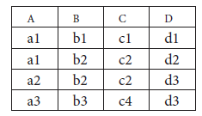
Functional Dependencies
Definition of Functional Dependency
Here, the following FDs may hold because the four tuples in the current extension have no violation of these constraints:
B → C;
C → B;
{A, B} → C;
{A, B} → D;
{C, D} → B
However, the following do not hold because we already have violations of them in the given extension:
A → B
B → A
D → C

Slide 35
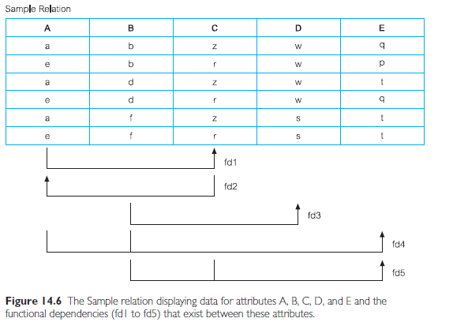
Functional Dependencies

Slide 36
Functional Dependencies
Definition of Functional Dependency
Figure 14.3
diagrammatic notation for displaying FDs
Each FD is displayed as a horizontal line.
The left-hand-side attributes of the FD are connected by vertical lines to the line representing the FD,
The right-hand-side attributes are connected by the lines with arrows pointing toward the attributes.

Slide 37
Properties of Functional Dependencies
Reflexivity
If X → Y & y is the subset of X , then X → X
An attribute determines itself
Always valid
Trivial FD
Transitivity
If (X → Y & Y → Z), then X → Z (might or might not be valid if any one of the condition in if case is false)
Augmentation
If (X → Y), then XA → YA
Union
If (X → Y & X → Z), then X → YZ
Decomposition
If (X → YZ ), then X → Y , X → Z
Converse is not true
Pseudo Transitivity
If (X → Y & YZ → A), then XZ → A
Composition
If (X → Y & A → B), then XA → YB
Roll No | Name | Marks | Department | Course
1 | Maryam | 78 | CS | OOP
2 | Maira | 60 | AI | OOP
3 | Maryam | 78 | CS | DB
4 | Maira | 60 | AI | ML
5 | Mohammad | 80 | SE | DB

Slide 38
Normal Forms Based on Primary Keys
Normalization of Relations
The normalization process, as first proposed by Codd (1972), takes a relation schema through a series of tests to certify whether it satisfies a certain normal form.
The process, which proceeds in a top-down fashion by evaluating each relation against the criteria for normal forms and decomposing relations as necessary.
Initially, Codd proposed three normal forms, which he called first, second, and third normal form.
A stronger definition of 3NF—called Boyce-Codd normal form (BCNF)—was proposed later by Boyce and Codd.
All these normal forms are based on a single analytical tool: the functional dependencies among the attributes of a relation.

Slide 39
Normal Forms Based on Primary Keys
Normalization of Relations
Normalization of data is a process of analyzing the given relation schemas based on their FDs and primary keys to achieve the desirable properties of
(1) minimizing redundancy and
(2) minimizing the insertion, deletion, and update anomalies.
An unsatisfactory relation schema that does not meet the condition for a normal form—the normal form test—is decomposed into smaller relation schemas that contain a subset of the attributes and meet the test that was otherwise not met by the original relation.

Slide 40
Normal Forms Based on Primary Keys
Normalization of Relations
Definition:
The normal form of a relation is the highest normal form condition that a relation meets,
and hence indicates the degree to which it has been normalized.
Existing designs are evaluated by applying the tests for normal forms, and normalization is carried out in practice so that the resulting designs are of high quality and meet the desirable properties stated previously.
Denormalization is a technique used by database administrators to optimize the efficiency of their database infrastructure. This method allows us to add redundant data into a normalized database to alleviate issues with database queries that merge data from several tables into a single table.

Slide 41
Normal Forms Based on Primary Keys
Definitions of Keys and Attributes Participating in Keys
Definition: A superkey of a relation schema R = {A1, A2, … , An} is a set of attributes S ⊆ R with the property that no two tuples t1 and t2 in any legal relation state r of R will have t1[S] = t2[S].
A key K is a superkey with the additional property that removal of any attribute from K will cause K not to be a super key anymore.
The difference between a key and a super key is that a key has to be minimal.
{Ssn} is a key for EMPLOYEE,
whereas {Ssn}, {Ssn, Ename}, {Ssn, Ename, Bdate}, and any set of attributes that includes Ssn are all superkeys.

Slide 42
Normal Forms Based on Primary Keys
Definitions of Keys and Attributes Participating in Keys
If a relation schema has more than one key, each is called a candidate key.
One of the candidate keys is arbitrarily designated to be the primary key, and the others are called secondary keys.
In a practical relational database, each relation schema must have a primary key.
If no candidate key is known for a relation, the entire relation can be treated as a default superkey.
{Ssn} is the only candidate key for EMPLOYEE, so it is also the primary key.

Slide 43
Normal Forms Based on Primary Keys
Definitions of Keys and Attributes Participating in Keys
Definition. An attribute of relation schema R is called a prime attribute of R if it is a member of some candidate key of R.
For example, {SSn,Ename} is a CK in R, then prime attributes are SSn and Ename.
An attribute is called nonprime if it is not a prime attribute—that is, if it is not a member of any candidate key.

Slide 44
Identifying SK and CK in a relation
Closure set / Attribute closure to find CK:
Represented as X⁺
X could be an attribute or a set of attributes
SUPERKEY: whose closure set contains all attributes of a relation R
Find closure set
If the closure set contains all attributes then it is a SK
Candidate Key: a key whose proper subset is not a SK
find proper subsets of a SK
and check if the closure sets of these are not SK then
It’s a candidate key
Question:
R(A,B,C,D,E)
FD ( A → B, B → C, C → D, D → E )

Slide 45
Identifying SK and CK in a relation
How to find SK and CK:
Question:
R(A,B,C,D,E)
FD ( A → B, D → E )
STEPS:
Find closures sets
Identify SK
Check if it’s a CK
find proper subsets of a SK
and check if the closure sets of these are not SK then
It’s a candidate key

Slide 46
Normal Forms Based on Primary Keys
First Normal Form
It states that the domain of an attribute must include only atomic (simple, indivisible) values and that the value of any attribute in a tuple must be a single value from the domain of that attribute.
Hence, 1NF disallows having a set of values, a tuple of values, or a combination of both as an attribute value for a single tuple.
The only attribute values permitted by 1NF are single atomic (or indivisible) values.

Slide 47
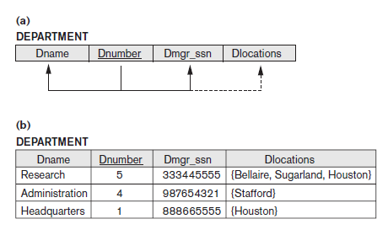
Normal Forms Based on Primary Keys
First Normal Form
Consider the DEPARTMENT relation schema shown in Figure 14.1, whose primary key is Dnumber, and suppose that we extend it by including the Dlocations attribute as shown in Figure 14.9(a).
We assume that each department can have a number of locations.
As we can see, this is not in 1NF because Dlocations is not an atomic attribute, as illustrated by the first tuple in Figure 14.9(b).

Slide 48
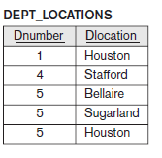
Normal Forms Based on Primary Keys
First Normal Form
FIRST OPTION:
Remove the attribute Dlocations that violates 1NF and place it in a separate relation DEPT_LOCATIONS along with the primary key Dnumber of DEPARTMENT.
The primary key of this newly formed relation is the combination {Dnumber, Dlocation}, as shown in Figure 14.2.
A distinct tuple in DEPT_LOCATIONS exists for each location of a department.
This decomposes the non-1NF relation into two 1NF relations.

Slide 49
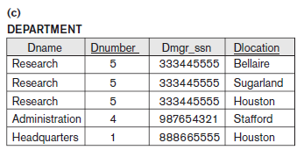
Normal Forms Based on Primary Keys
First Normal Form
SECOND OPTION:
Expand the key so that there will be a separate tuple in the original DEPARTMENT relation for each location of a DEPARTMENT.
In this case, the primary key becomes the combination {Dnumber, Dlocation}.
This solution has the disadvantage of introducing redundancy in the relation which leads to updated anomalies and hence is rarely adopted.

Slide 50
Normal Forms Based on Primary Keys
First Normal Form
THIRD OPTION:
If a maximum number of values is known for the attribute—for example, if it is known that at most three locations can exist for a department—replace the Dlocations attribute by three atomic attributes: Dlocation1, Dlocation2, and Dlocation3.
Disadvantage:
NULL values ~ if most departments have fewer than three locations.
Querying on this attribute becomes more difficult;
for example, consider how you would write the query: List the departments that have ‘Bellaire’ as one of their locations in this design.
For all these reasons, it is best to avoid this alternative.

Slide 51
Normal Forms Based on Primary Keys
First Normal Form
THIRD OPTION:
Of the three solutions above, the first is generally considered best because it does not suffer from redundancy and it is completely general; it places no maximum limit on the number of values.
In fact, if we choose the second solution, it will be decomposed further during subsequent normalization steps into the first solution.

Slide 52
Normal Forms Based on Primary Keys
First Normal Form
THIRD OPTION:
1NF also disallows multivalued attributes that are themselves composite.
These are called nested relations because each tuple can have a relation within it.
Figure 14.10 shows how the EMP_PROJ relation could appear if nesting is allowed.
In EMP_Proj -> shows each employee entity with the projects on which he/she is working.
The schema of this EMP_PROJ relation can be represented as follows:
EMP_PROJ(Ssn, Ename, {PROJS(Pnumber, Hours)})
The set braces { } identify the attribute PROJS as multivalued, and we list the component attributes that form PROJS between parentheses ( ).

Slide 53
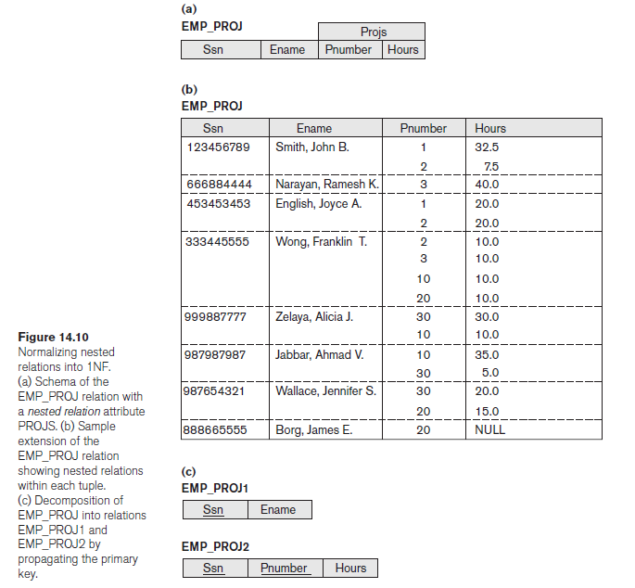
Normal Forms Based on Primary Keys
First Normal Form
Ssn is the primary key of the EMP_PROJ relation in Figures 14.10(a) and (b),
whereas Pnumber is the partial key of the nested relation; that is, within each tuple, the nested relation must have unique values of Pnumber.
Figure 14.10 (c) shows the solution.
To normalize this into 1NF, we remove the nested relation attributes into a new relation and propagate the primary key into it; the primary key of the new relation will combine the partial key with the primary key of the original relation.

Slide 54
Normal Forms Based on Primary Keys
First Normal Form
This procedure can be applied recursively to a relation with multiple-level nesting to un nest the relation into a set of 1NF relations.
This is useful in converting an un normalized relation schema with many levels of nesting into 1NF relations.
As an example, consider the following:
CANDIDATE (Ssn, Name, {JOB_HIST (Company, Highest_position, {SAL_HIST (Year, Max_sal)})})
The first normalization using internal partial keys Company and Year,respectively, results in the following 1NF relations:
CANDIDATE_1 (Ssn, Name)
CANDIDATE_JOB_HIST (Ssn, Company, Highest_position)
CANDIDATE_SAL_HIST (Ssn, Company, Year, Max-sal)

Slide 55
Normal Forms Based on Primary Keys
Second Normal Form
Second normal form (2NF) is based on the concept of full functional dependency.
A functional dependency X → Y is a full functional dependency if removal of any attribute A from X means that the dependency does not hold anymore; that is, for any attribute A ε X, (X − {A}) does not functionally determine Y.
The dependency {Ssn, Pnumber} → Hours is a full dependency
(neither Ssn → Hours nor Pnumber → Hours holds).
A functional dependency X → Y is a partial dependency if some attribute A ε X can be removed from X and the dependency still holds; that is, for some A ε X, (X − {A}) → Y.
The dependency {Ssn, Pnumber} → Ename is partial
because Ssn → Ename holds.
Definition:
A relation schema R is in 2NF if every nonprime attribute A in R is fully functionally dependent on the primary key of R. ~ NO PARTIAL DEPENDENCY
And table should be in 1NF.

Slide 56
Normal Forms Based on Primary Keys
Second Normal Form
Second normal form (2NF) is based on the concept of full functional dependency.
A functional dependency X → Y is a full functional dependency if removal of any attribute A from X means that the dependency does not hold anymore; that is, for any attribute A ε X, (X − {A}) does not functionally determine Y.
The dependency {Ssn, Pnumber} → Hours is a full dependency
(neither Ssn → Hours nor Pnumber → Hours holds).
A functional dependency X → Y is a partial dependency if some attribute A ε X can be removed from X and the dependency still holds; that is, for some A ε X, (X − {A}) → Y.
The dependency {Ssn, Pnumber} → Ename is partial
because Ssn → Ename holds.
Definition:
A relation schema R is in 2NF if every nonprime attribute A in R is fully functionally dependent on the primary key of R. ~ NO PARTIAL DEPENDENCY
And table should be in 1NF.

Slide 57
CHECK for 2NF
Check for Partial depndencies
Question:
R(A,B,C,D,E)
FD ( A → B, D → E )
STEPS:
Find CK
Check if non prime attributes are determined by part of Ck
Solution:
Prime attributes:
Non-prime attributes:
CK = ACD
Check if B or E are determined by either A / C / D / AC / CD / AD
only then it’s a partial dependency.
If Partial dependency exists, then decompose the relation

Slide 58
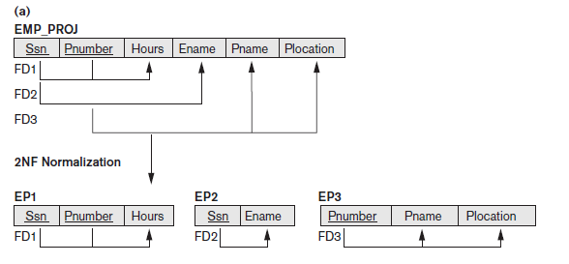
Normal Forms Based on Primary Keys
Prime attribute: SSN,Pnumber
Non- Prime attribute: hours, ename, pname, plocation
Partial dependencies:
SSn → ename ,
Pnumber → Pname,
Pnumber → Plocation
Second Normal Form
The test for 2NF involves
testing for FD whose left-hand side attributes are part of the primary key.
The EMP_PROJ relation in Figure 14.3(b) is in 1NF but is not in 2NF.
The nonprime attribute Ename violates 2NF because of FD2, as do the nonprime attributes Pname and Plocation because of FD3.

Slide 59
Normal Forms Based on Primary Keys
Third Normal Form
Third normal form (3NF) is based on the concept of transitive dependency.
A functional dependency X → Y in a relation schema R is a transitive dependency if there exists a set of attributes Z in R that is neither a candidate key nor a subset of any key of R, and both X → Z and Z → Y hold.
Transitive dependencies in EMP_DEPT(SSN, Ename, Dnumber, Dname, Dlocations, Dmgr_SSn) could be :
Ssn → Dnumber and Dnumber → Dmgr_ssn hold and Dnumber is neither a key itself nor a subset of the key of EMP_DEPT.
The dependency Ssn → Dmgr_ssn is transitive through Dnumber in EMP_DEPT because both the dependencies, and Dnumber is not a prime attribute.
Definition: A relation schema R is in 3NF if
it satisfies 2NF and
no nonprime attribute of R is transitively dependent on the primary key. (or no non prime attribute is determined by a non prime attribute)

Slide 60
CHECK for 3NF
Check for Transitive dependencies
Question:
R(A,B,C,D,E,F)
FD ( AB → CDEF, BD → F)
STEPS:
Find CK
Then identify if any non prime attribute is determined by a non prime attribute.
Solution:
Prime attributes:
Non-prime attributes:
CK = AB
Check if non prime attributes are determined by any non-prime attribute except AB
only then it’s a transitive dependency.
If transitive dependencies exist, then decompose the relation

Slide 61
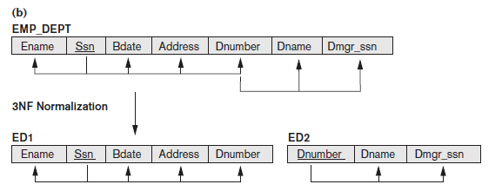



Normal Forms Based on Primary Keys
Prime attribute: SSN
Non- Prime attribute: ename,bdate,address,dnumber,dname,Dmgr_SSN
dependencies:
SSn → Ename, Bdate, Address, Dnumber
Dnumber → Dname, Dmgr_SSN

Slide 62
Normal Forms Based on Primary Keys
Third Normal Form
A NATURAL JOIN operation on ED1 and ED2 will recover the original relation EMP_DEPT without generating spurious tuples.

Slide 63
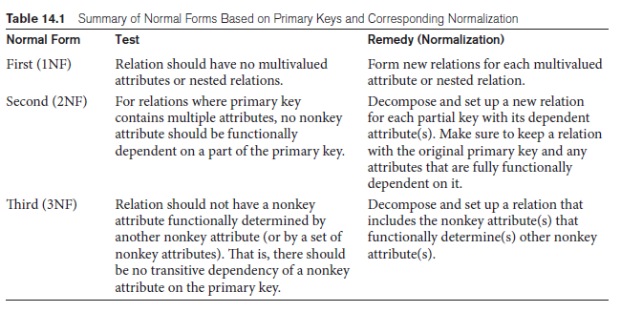
General Definitions of Second and Third Normal Forms

Slide 64
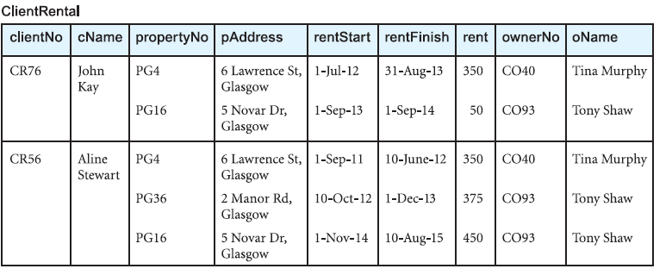
Normal Forms Based on Primary Keys
Example:
A client can rent multiple properties of different owners
Key attribute is clientNo.
Repeating Group = propertyNo, pAddress, rentStart, rentFinish, rent, ownerNo, oName

Slide 65
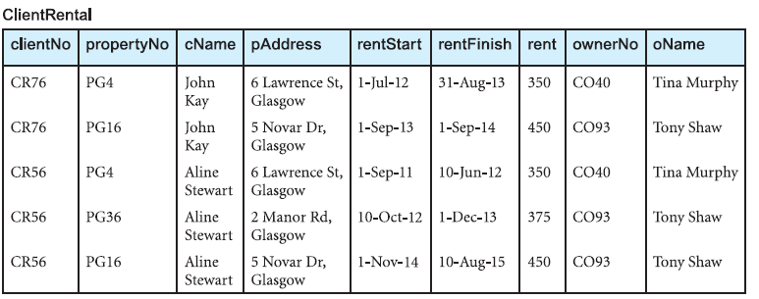
Normal Forms Based on Primary Keys
Example:
1NF – 2 APPROACHES
FIRST APPROACH
Client no and property no is a composite key here
The relation contains data redundancy.
If implemented, the 1NF relation would be subject to the update anomalies.

Slide 66
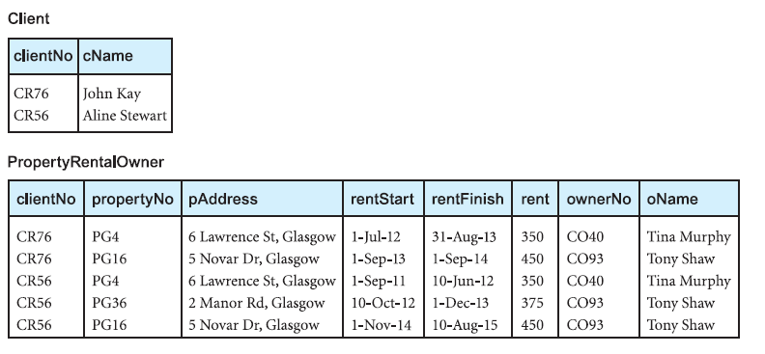

Normal Forms Based on Primary Keys
Example:
1NF – 2 APPROACHES
SECOND APPROACH
Remove the repeating group (property rented details) by placing the repeating data along with a copy of the original key attribute (clientNo) in a separate relation.

Slide 67
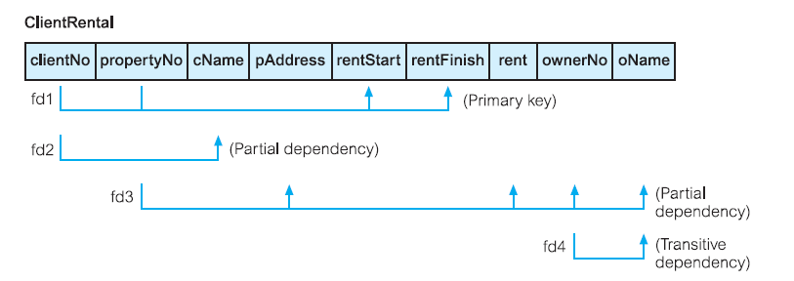
Normal Forms Based on Primary Keys
Example:
FD

Slide 68
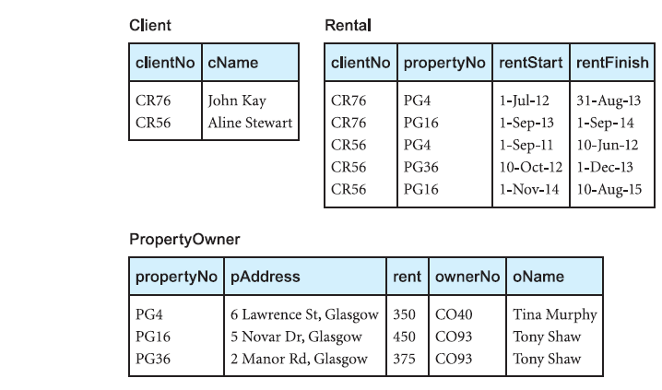
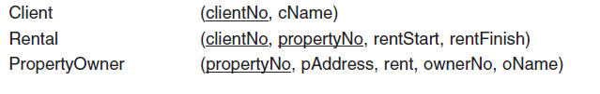
Normal Forms Based on Primary Keys
Example:
2NF
If a partial dependency exists, we remove the partially dependent attribute(s) from the relation by placing them in a new relation along with a copy of their determinant.
Client attribute (cName) is partially dependent on the primary key(represented as fd2).
The property attributes (pAddress, rent, ownerNo, oName) are partially dependent on the primary key, that is, on only the propertyNo attribute (represented as fd3).

Slide 69
Normal Forms Based on Primary Keys
Example:
3NF
Although 2NF relations have less redundancy than those in 1NF, they may still suffer from update anomalies.
For example,
if we want to update the name of an owner, such as Tony Shaw (ownerNo CO93),
we have to update two tuples in the PropertyOwner relation.
If we update only one tuple and not the other, the database would be in an inconsistent state.
This update anomaly is caused by a transitive dependency.

Slide 70
Normal Forms Based on Primary Keys
Example:
3NF
SOLUTION:
If a transitive dependency exists, we remove the transitively dependendent attribute(s) from the relation by placing the attribute(s) in a new relation along with a copy of the determinant.

Slide 71
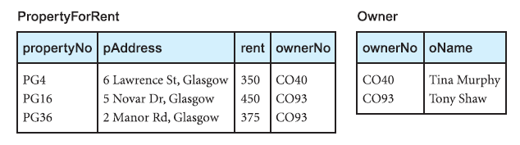

Normal Forms Based on Primary Keys
Example:
3NF
FD4 rectified here as:
By transforming the PropertyOwner relation into two new relations called PropertyForRent and Owner.

Slide 72
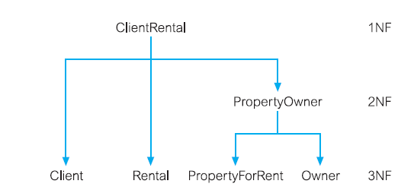
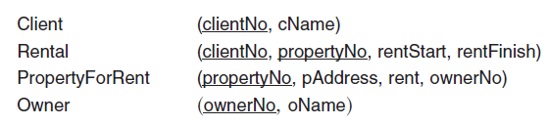
Normal Forms Based on Primary Keys
Example:
The original ClientRental relation can be recreated by joining the Client, Rental, PropertyForRent, and Owner relations through the primary key/ foreign key mechanism.
For example, the ownerNo attribute is a primary key within the Owner relation and is also present within the PropertyForRent relation as a foreign key.

Slide 73
Normal Forms Based on Primary Keys
Example:
The clientNo attribute is a primary key of the Client relation and is also present within the Rental relation as a foreign key.
Note that in this case the clientNo attribute in the Rental relation acts both as a foreign key and as part of the primary key of this relation.
Similarly, the propertyNo attribute is the primary key of the PropertyForRent relation and is also present within the Rental relation acting both as a foreign key and as part of the primary key for this relation.

Slide 74
Normal Forms Based on Primary Keys
Example:
In other words, the normalization process has decomposed the original ClientRental relation.
This results in a lossless-join (also called non lossy or non additive-join) decomposition, which is reversible.
As natural join won’t result in generation of spurious tuples

Slide 75
General Definitions of 2NF & 3NF
General Definition of Second Normal Form
Definition.
A relation schema R is in 2NF if, every nonprime attribute A in R is not partially dependent on ANY KEY of R.
The test for 2NF
check for functional dependencies whose left-hand side attributes are part of the primary key.
If the primary key contains a single attribute, the test need not be applied at all.

Slide 76
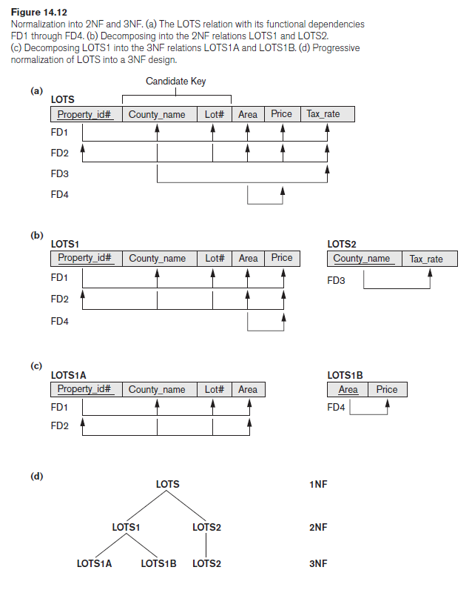
General Definitions of 2NF & 3NF
General Definition of Second Normal Form
Consider the relation schema LOTS which describes parcels of land for sale in various counties of a state.
Suppose that there are two candidate keys:
Property_id#
{County_name, Lot#}
Lot# are unique only within each county,
but Property_id# are unique across counties for the entire state.

Slide 77
General Definitions of 2NF & 3NF
General Definition of Second Normal Form
Following FDs hold in the given schema:
FD1: Property_id# → county_name, Lot#,Area, price,Tax_rate
FD2: {County_name, Lot#} → property_Id#, Area, price,Tax_rate
FD3: County_name → Tax_rate
Assume:
the tax rate is fixed for a given county
does not vary lot by lot within the same county
FD4: Area → Price
Assume:
The price of a lot is determined by its area regardless of the county it is in.

Slide 78
General Definitions of 2NF & 3NF
Identify FDs
Remove partial dependencies on candidate key
Remove transitive dependencies
Finalized schema

Slide 79
General Definitions of 2NF & 3NF
General Definition of Second Normal Form
2NF violation:
FD3: Tax_rate is partially dependent on the candidate key {County_name, Lot#}.
Solution:
decompose it into the two relations LOTS1 and LOTS2.
We construct LOTS1 by removing the attribute Tax_rate that violates 2NF from LOTS and placing it with County_name (the left-hand side of FD3 that causes the partial dependency) into another relation LOTS2.
Both LOTS1 and LOTS2 are in 2NF.

Slide 80
General Definitions of 2NF & 3NF
General Definition of Third Normal Form
Definition.
A relation schema R is in third normal form (3NF) if,
whenever a nontrivial functional dependency X → A holds in R,
Either (a) X is a super key of R,
or (b) A is a prime attribute of R.

Slide 81
General Definitions of Second and Third Normal Forms
General Definition of Third Normal Form
3NF violation:
FD4: Area → Price
Here, Area is not a superkey and Price is not a prime attribute in LOTS1.
Solution:
we decompose LOTS1 into the relation schemas LOTS1A and LOTS1B.
We construct LOTS1A by removing the attribute Price that violates 3NF from LOTS1 and placing it with Area (the left-hand side of FD4 that causes the transitive dependency) into another relation LOTS1B.

Slide 82
General Definitions of Second and Third Normal Forms
General Definition of Third Normal Form
LOTS1 violates 3NF because Price is transitively dependent on each of the candidate keys of LOTS1 via the nonprime attribute Area.
This general definition can be applied directly to test whether a relation schema is in 3NF;
it does not have to go through 2NF first.
In other words, if a relation passes the general 3NF test, then it automatically passes the 2NF test.
If we apply the GENERAL 3NF definition to LOTS with the dependencies FD1 through FD4,
we find that both FD3 and FD4 violate 3NF because the LHS County_name in FD3 is not a super key.

Slide 83
General Definitions of Second and Third Normal Forms
Interpreting the General Definition of Third Normal Form
A relation schema R violates the general definition of 3NF if a functional dependency X → A holds in R that meets either of the two conditions, namely (a) and (b).
The first condition “catches” two types of problematic dependencies:
A nonprime attribute determines another nonprime attribute. Here we typically have a transitive dependency that violates 3NF.
A proper subset of a key of R functionally determines a nonprime attribute. Here we have a partial dependency that violates 2NF.

Slide 84
General Definitions of Second and Third Normal Forms
Interpreting the General Definition of Third Normal Form
Therefore, we can state a general alternative definition of 3NF as follows:
A relation schema R is in 3NF if every nonprime attribute of R meets both of the following conditions:
It is fully functionally dependent on every key of R.
It is non transitively dependent on every key of R.

Slide 85
General Definitions of Boyce Codd Normal Form
General Definition of BCNF
Definition.
A relation is in BCNF if & only if,
Relation is in 3NF &
For each FD in R,
The left hand side of all FDs are a Super key (i.e., X → A holds in R, then X is a super key of R.)
Scenario for BCNF violation:
check if a FD : X → A , here X is a non prime attribute but A is prime attribute.
Now, relation is in 3NF but not in BCNF.

Slide 86
Boyce-Codd Normal Form
Boyce-Codd Normal Form
Assume,
we have thousands of lots in the relation
but the lots are from only two counties: DeKalb and Fulton.
lot sizes 0.5, 0.6, 0.7, 0.8, 0.9, and 1.0 acres are only in DeKalb County
lot sizes 1.1, 1.2, … , 1.9, and 2.0 acres are only in Fulton County
In such a situation we would have the additional functional dependency FD5: Area → County_name.
County_name is a prime attribute, but Area is a non –prime attribute ~ BCNF violation
CKs were Property_id# and {County_name, Lot#}

Slide 87
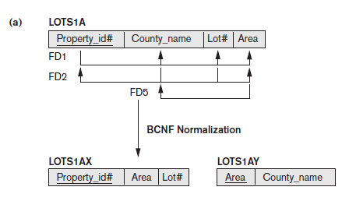
Boyce-Codd Normal Form
Boyce-Codd Normal Form (Decomposition of tables)

Slide 88

Boyce-Codd Normal Form
Decomposition of Relations not in BCNF
A relation TEACH with the following dependencies:
FD1: {Student, Course} → Instructor
FD2:Instructor → Course
Note that {Student, Course} is a candidate key for this relation.
Hence this relation is in 3NF but not BCNF.
Decomposition of this relation schema may be done in multiple ways.like:
R {instructor, course } and R {instructor, student}
R {instructor, course } and R {course, student}

Slide 89
Boyce-Codd Normal Form
The decomposition for relation TEACH
R {instructor, course } and R {instructor, student}
This decomposition will lose fd1

Slide 90
Fourth Normal Form (4NF)
Definition:
A relation will be in 4NF if:
It is in Boyce Codd normal form and has no multi-valued dependency
AND For a dependency A → B, if for a single value of A, multiple values of B exists, then the relation will be a multi-valued dependency.
Example:
R (Student, course, Hobbies)
Student Course
Student Hobbies
Here course & hobbies should be independent
redundant data
R (Employee#, Project#, DependentName)
Employee Project
Employee DependenctName

Slide 91
Fifth Normal Form (5NF)
Definition:
A relation will be in 5NF if:
It is in 4th normal form and has no multi-valued dependency
AND no lossy join conditions are there. i.e., no join dependencies exists in the table.
Can be avoided when decomposition of tables are done in a way that there reconstruction leads to same data values & no spurious tuples are generated.

Slide 92
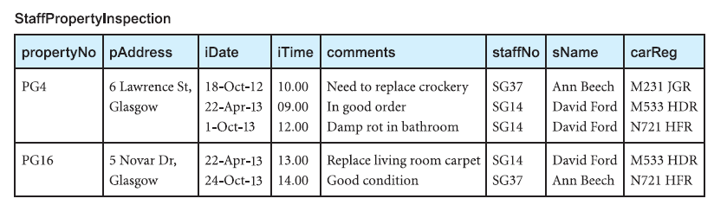
Boyce-Codd Normal Form
Example:

Slide 93
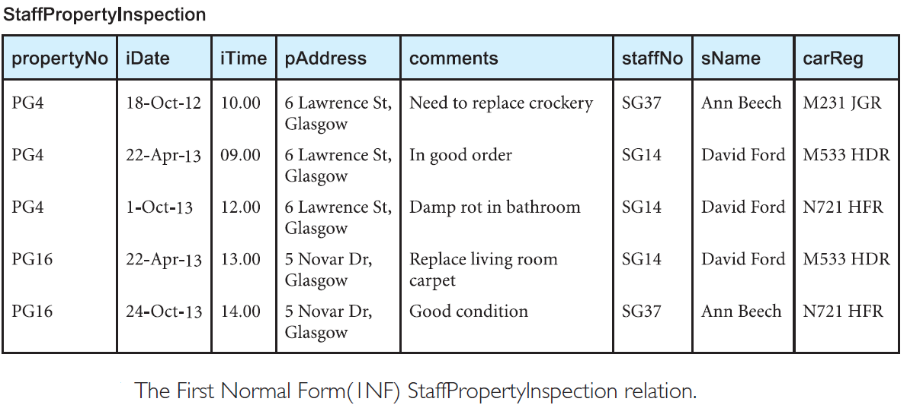
Boyce-Codd Normal Form
Example:

Slide 94
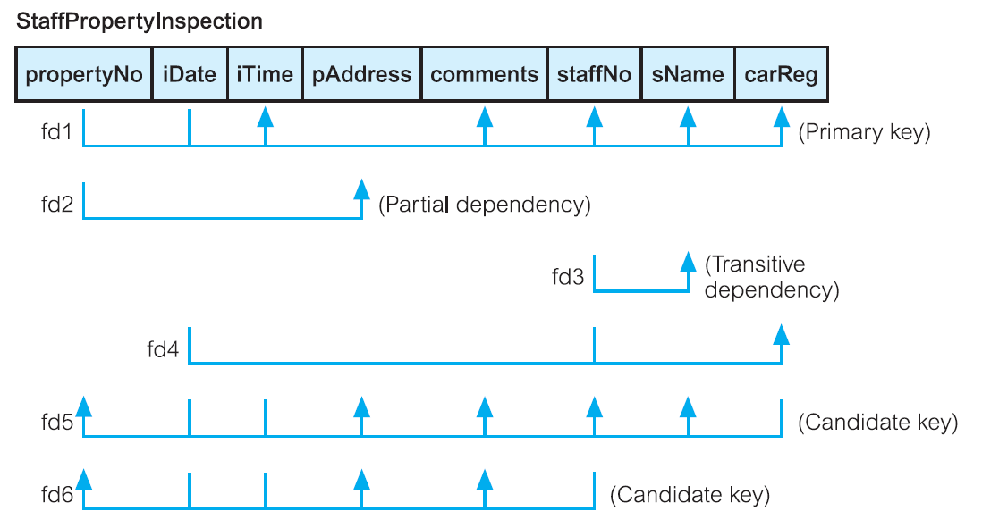
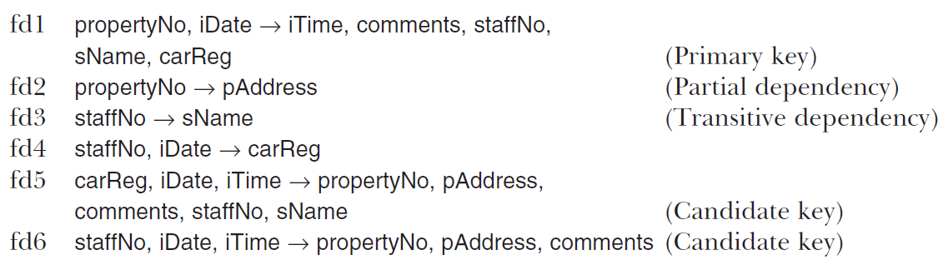
Boyce-Codd Normal Form
Example:

Slide 95

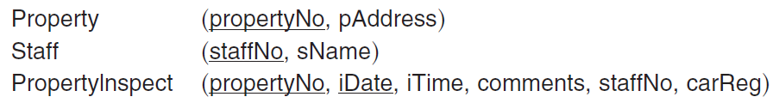

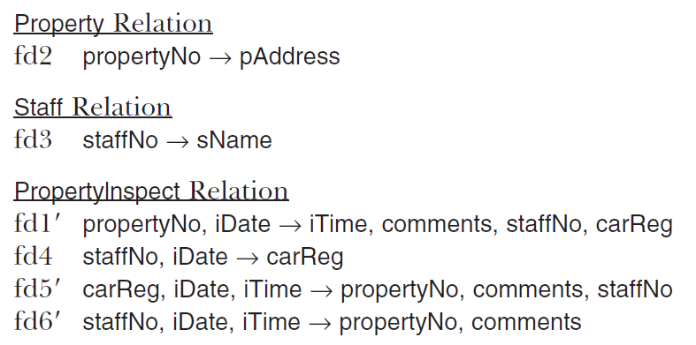
Second Normal Form (2NF)
Third Normal Form (3NF)
Boyce–Codd Normal Form (BCNF)

Slide 96
